Slide 1
GRADIENT/XG BOOST

Slide 2
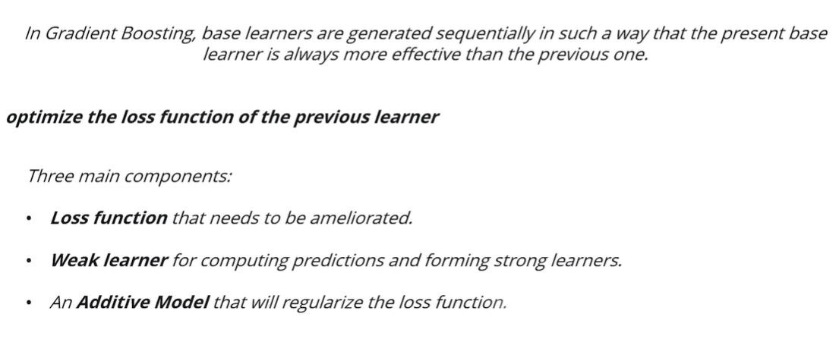
Gradient Boosting

Slide 3

The boosting ensemble technique consists of three simple steps:
  An initial model F0 is defined to predict the target variable y. This model will be associated with a residual (y – F0)
  A new model h1 is fit to the residuals from the previous step
  Now, F0 and h1 are combined to give F1, the boosted version of F0. The mean squared error from F1 will be lower than that from F0:

Slide 4


To improve the performance of F1, we could model after the residuals of F1 and create a new model F2:
This can be done for ‘m’ iterations until residuals have been minimized as much as possible:

Slide 5
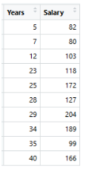

Example
As the first step, the model should be initialized with a function F0(x).
F0(x) should be a function that minimizes the loss function or MSE (mean squared error),
In this case:

Slide 6

Taking the first differential of the above equation with respect to γ (learning rate) ,
it is seen that the function minimizes at the mean i=1ny
So, the boosting model could be initiated with:

Slide 7
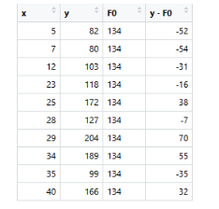
F0(x) gives the predictions from the first stage of our model.
Now, the residual error for each instance is (yi – F0(x)). Where F0 is the average

Slide 8
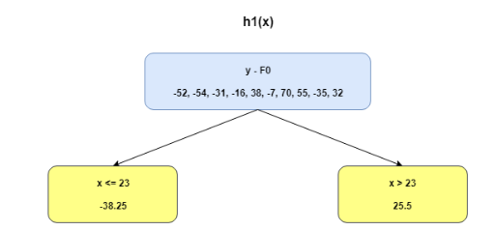
We can use the residuals from F0(x) to create h1(x).
h1(x) will be a regression tree that will try and reduce the residuals from the previous step.
The output of h1(x) won’t be a prediction of y; instead, it will help in predicting the successive function F1(x) which will bring down the residuals.

Slide 9
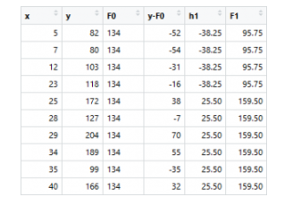
The additive model h1(x) computes the mean of the residuals (y – F0) at each leaf of the tree.
The boosted function F1(x) is obtained by summing F0(x) and h1(x).
This way h1(x) learns from the residuals of F0(x) and suppresses it in F1(x).
h1 - New Prediction Value
F1 = F0+h1

Slide 10
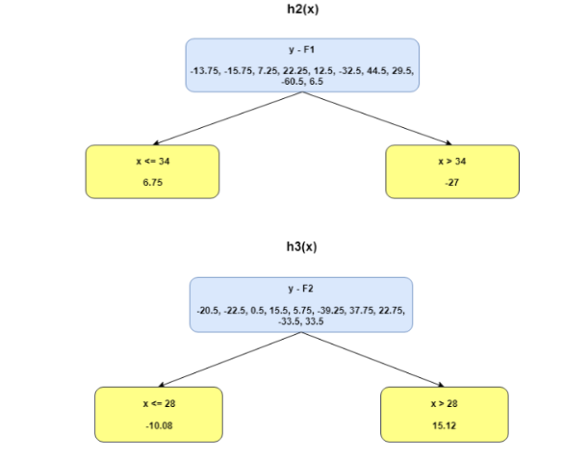
This can be repeated for 2 more iterations to compute h2(x) and h3(x).
Each of these additive learners,
hm(x), will make use of the residuals from the preceding function, Fm-1(x).

Slide 11
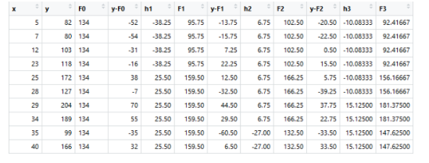
XG Boost- Example
h1 - New Prediction Value
F1 = F0+h1

Slide 12
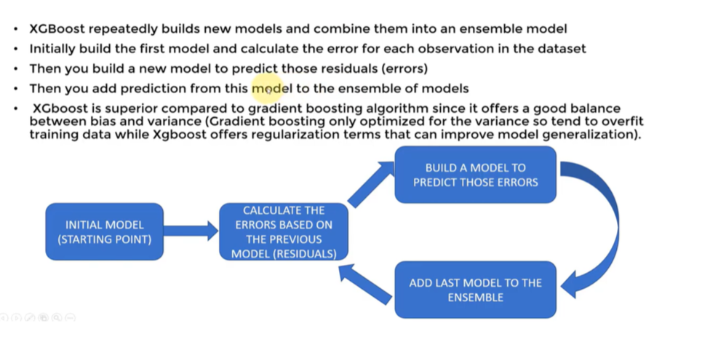
XG Boost Steps

Slide 13
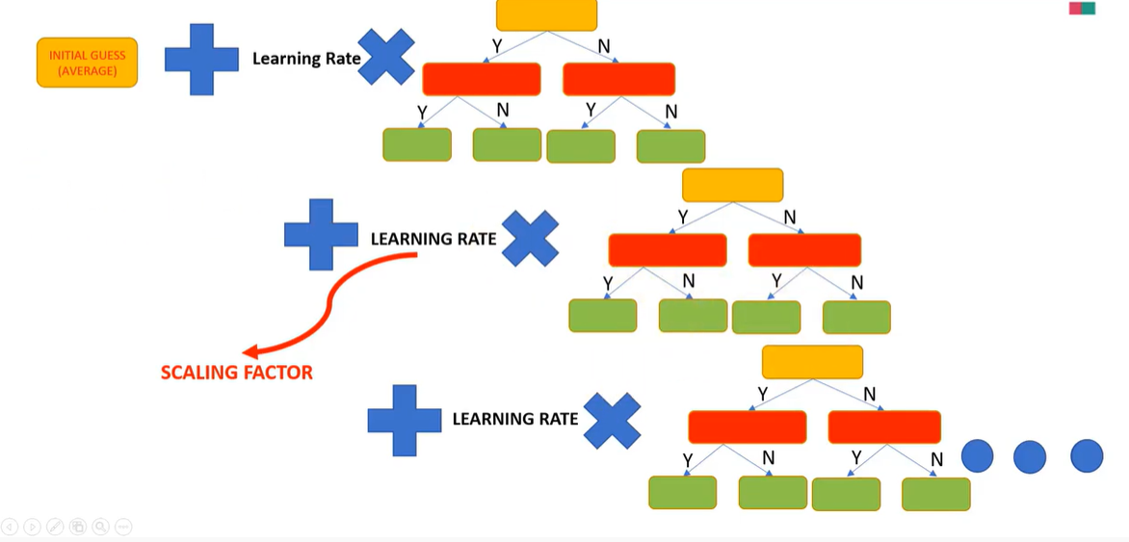
GRADIENT BOOSTING

Slide 14
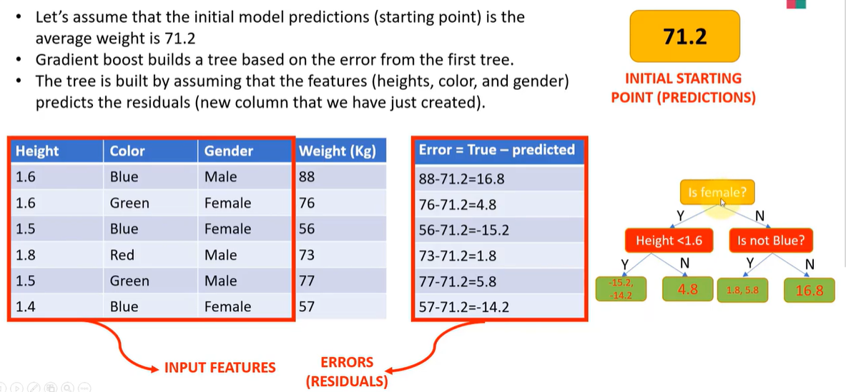
GRADIENT BOOSTING
Create the tree to predict the Residuals

Slide 15
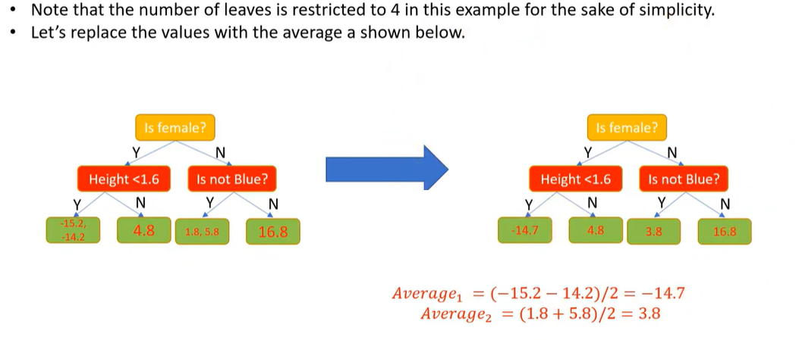
GRADIENT BOOSTING

Slide 16
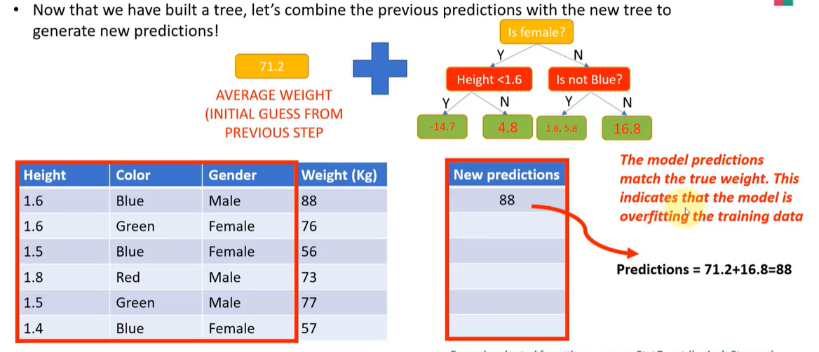
GRADIENT BOOSTING- Overfitting Scenario

Slide 17
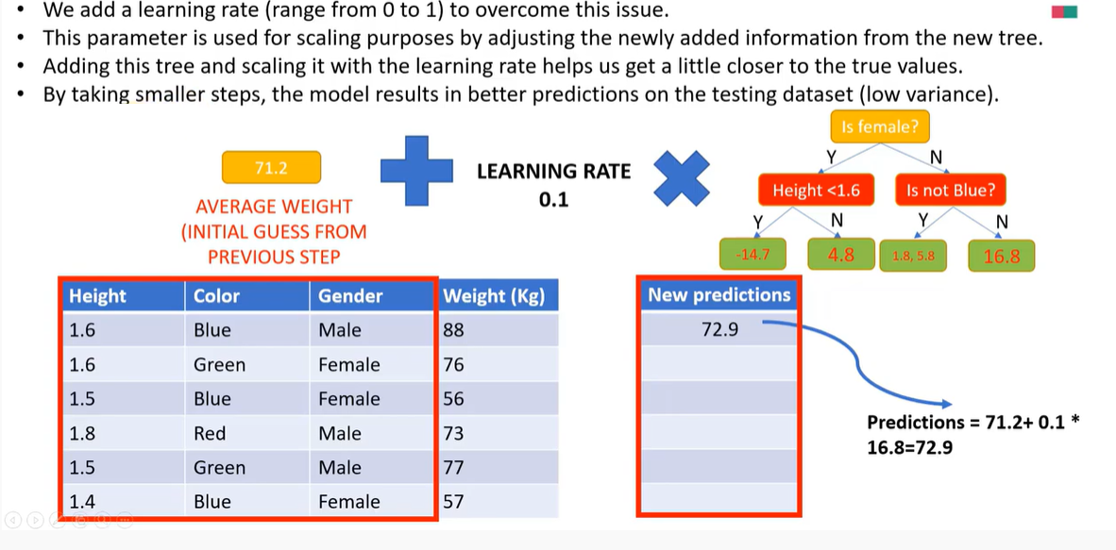
GRADIENT BOOSTING- Add Learning Rate to reduce Overfitting issue

Slide 18
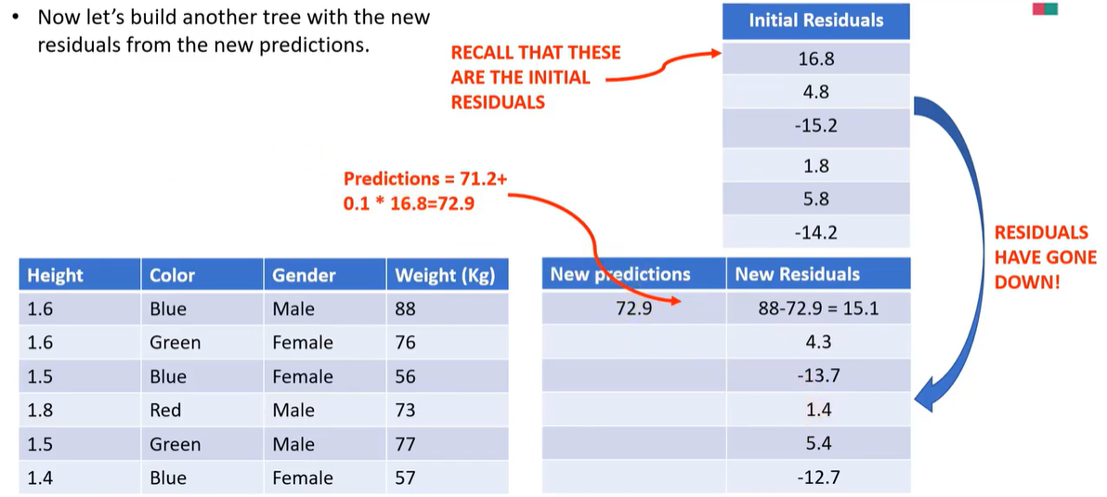
GRADIENT BOOSTING- New Residuals

Slide 19
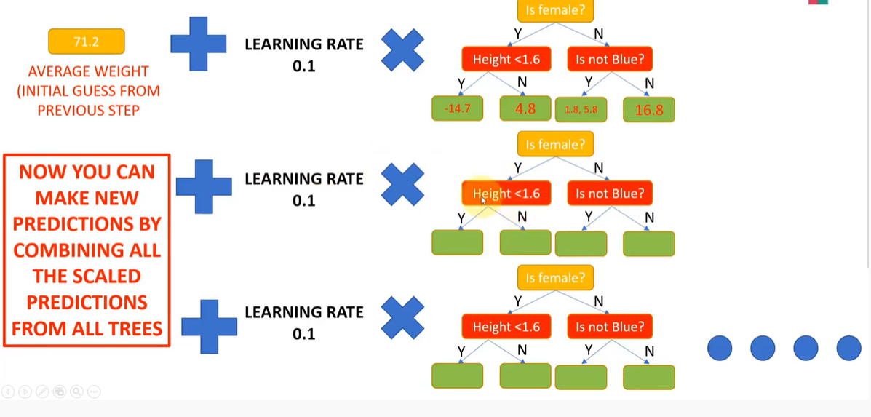
GRADIENT BOOSTING

Slide 20
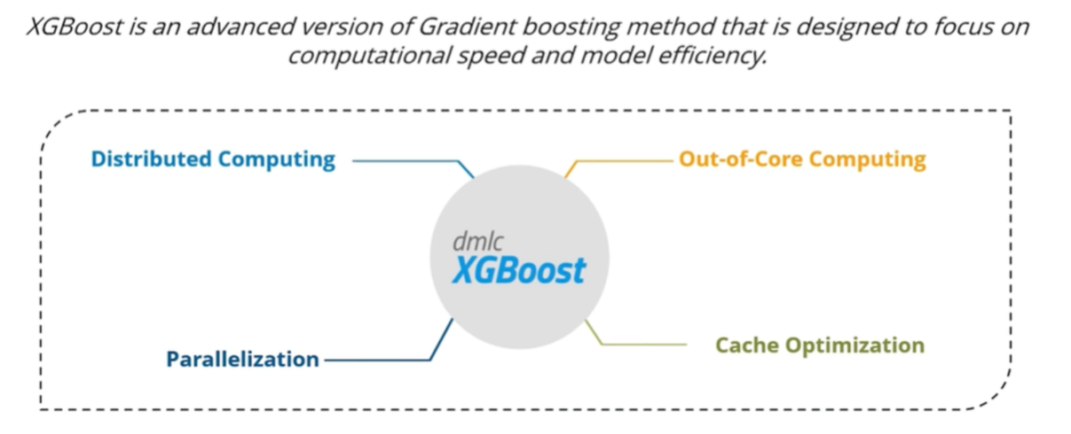
XG Boost

Slide 21
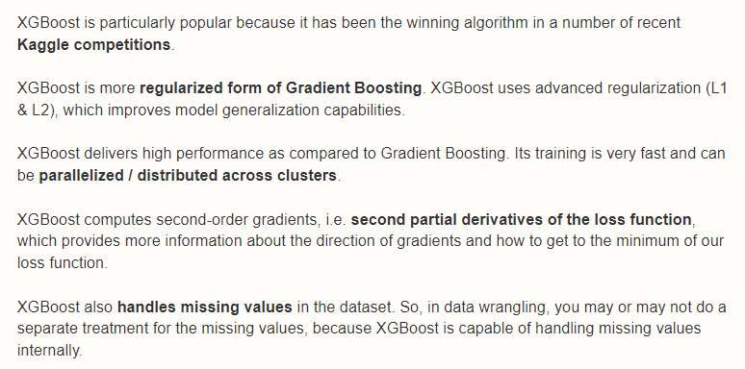
Advantage XG Boost over Gradient Boosting

Slide 22
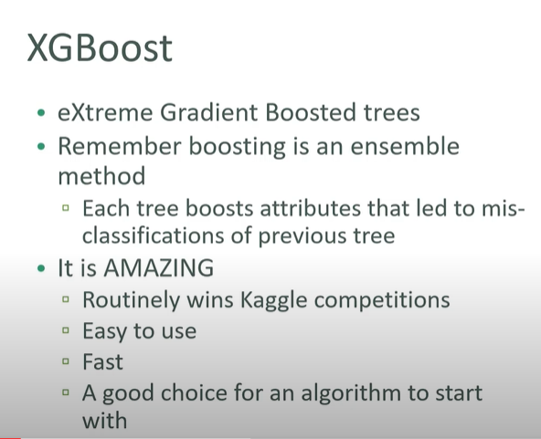

Slide 23
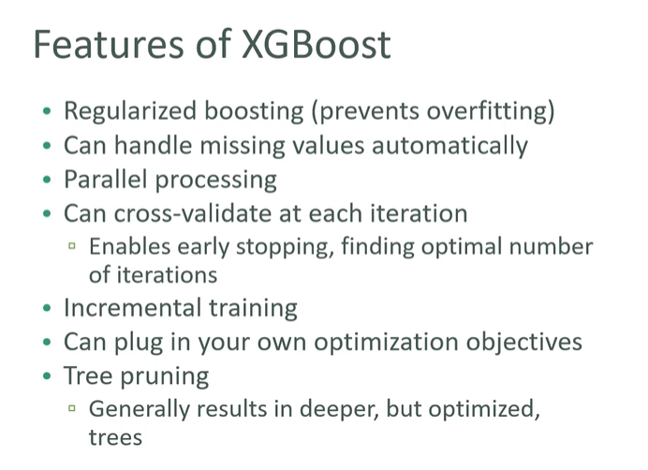

Slide 24
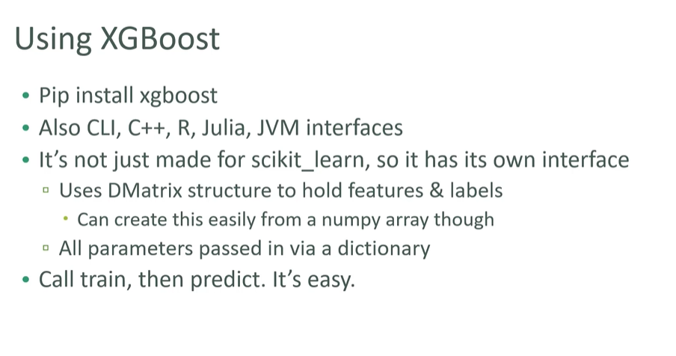

Slide 25
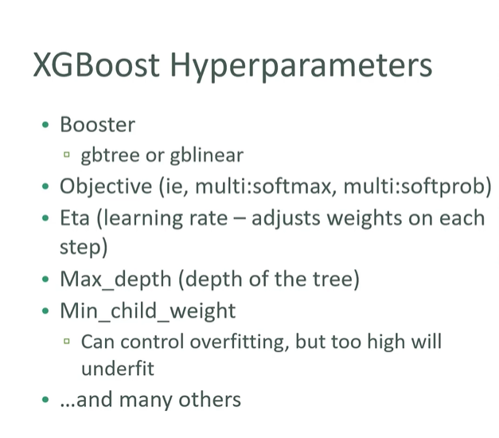

Slide 26
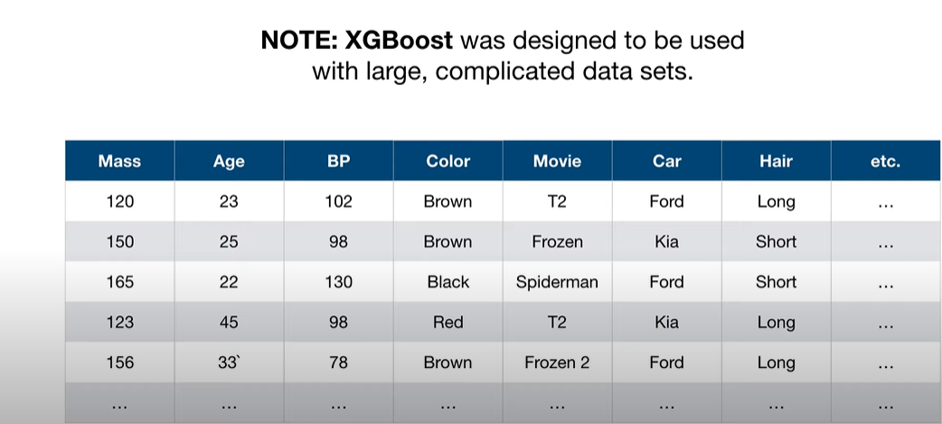

Slide 27
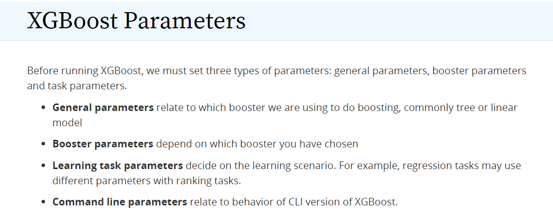
Link for XG Boost Parameters
https://xgboost.readthedocs.io/en/latest/parameter.html

Slide 28
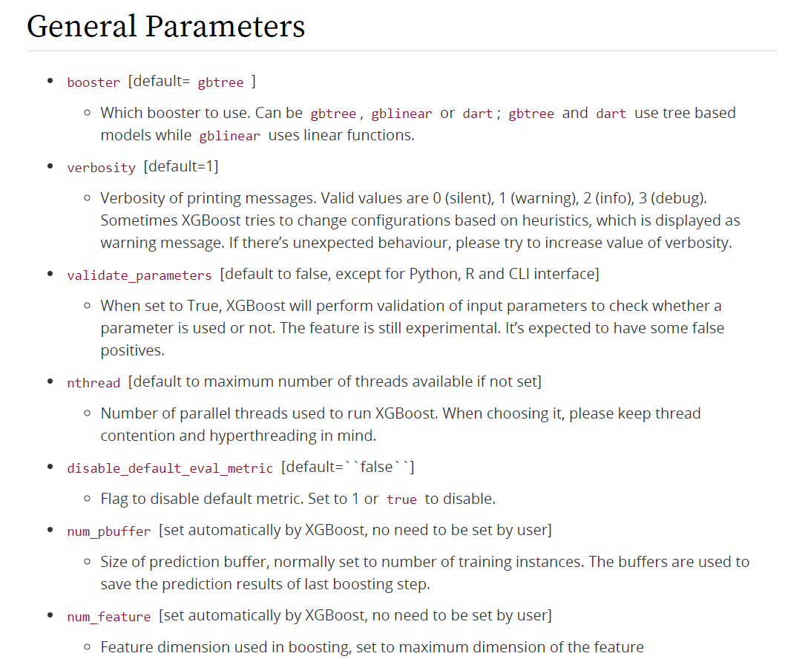

Slide 29
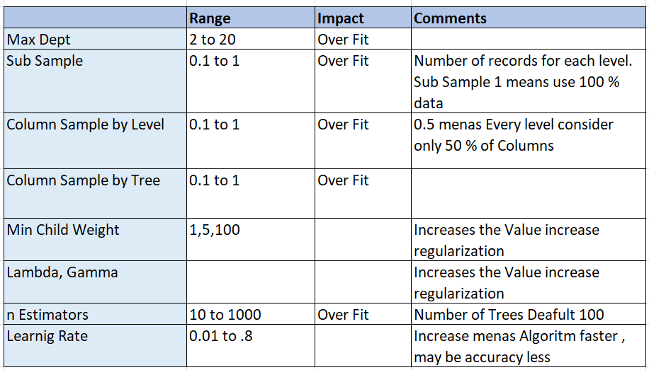
XG Boost Parameters
https://xgboost.readthedocs.io/en/latest/parameter.html

